Slide 1


VOCABLOOT
Vocabulary learning
should feel like play.
Snap the world! Learn the words!
Product overview · Press kit
Notes:
[Sources]
- First-party brand artwork: marketing/photo-illustration/vocabloot-main-photo-illustration-v1.png

Slide 2
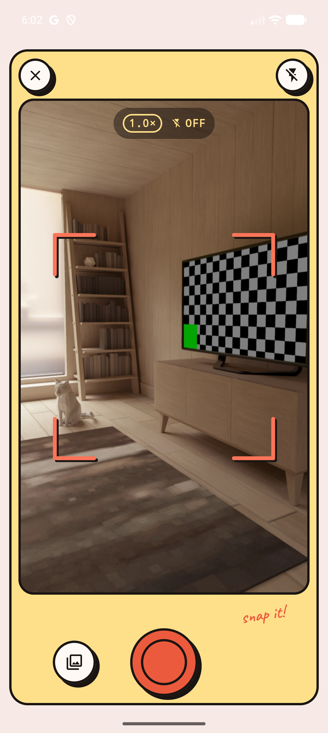
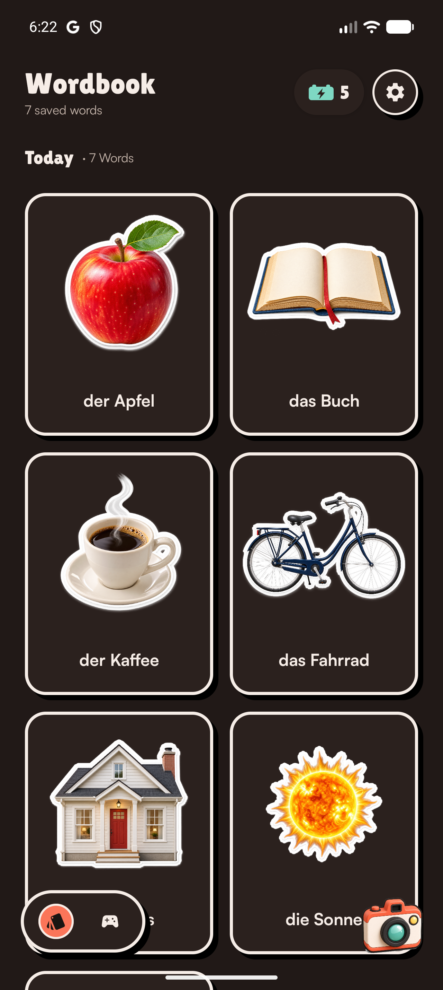
THE CORE EXPERIENCE
The world becomes the vocabulary list.
Point the camera at everyday life.
Instead of starting with generic flashcards, learners photograph objects around them and discover their names in the language they are learning.
Snap the world! Learn the words!
02
Notes:
[Sources]
- Fresh Android emulator captures made from the current Vocabloot debug build: 02-camera.png and 35-wordbook-clean.png. Wordbook content was imported from an SLBK1 temporary backup built from the approved vocabloot-content German A1 assets.

Slide 3
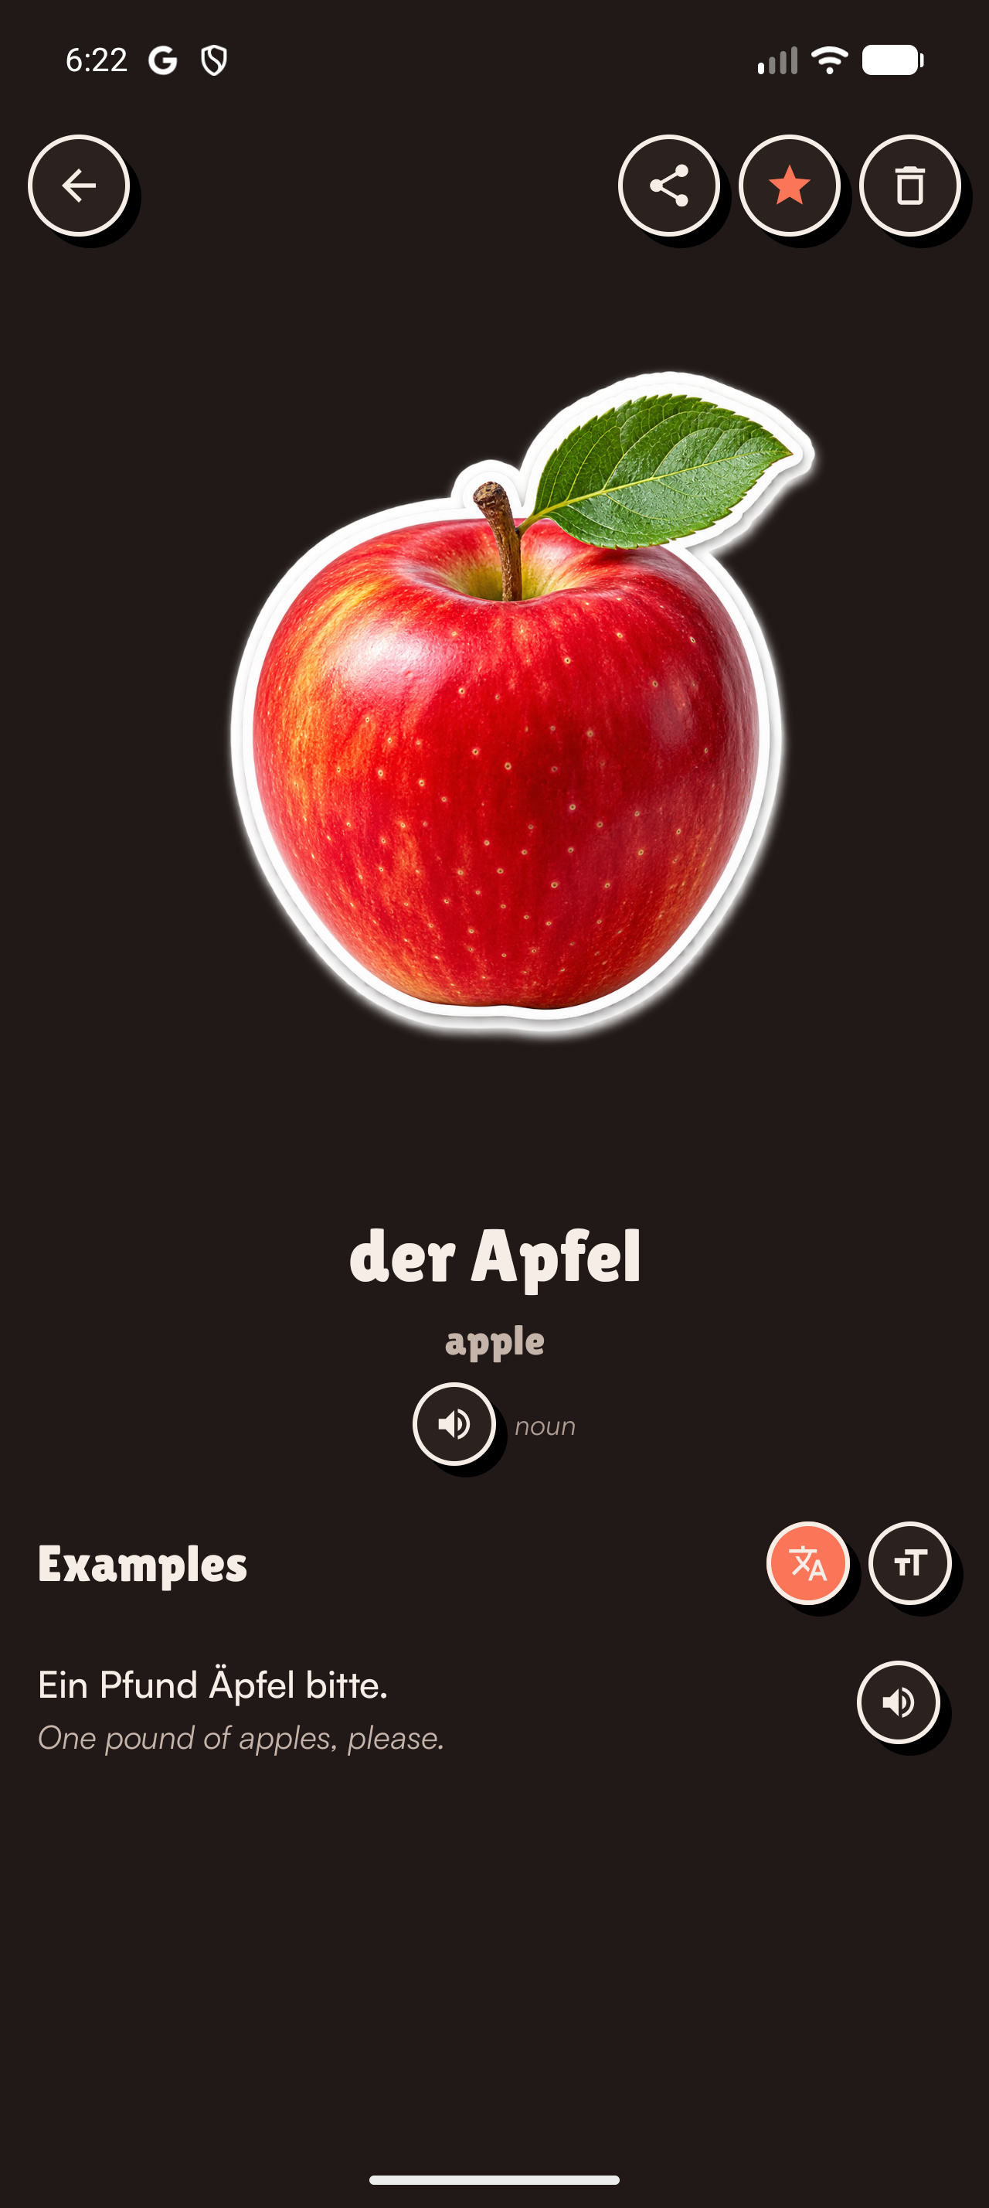
TAP AND HEAR
Every discovered word becomes audible.
Voice lives inside the word, not beside it.
Tap the saved word to hear natural pronunciation.
Play full example sentences with expressive voice.
Connect the written form with the way the word sounds in context.
03
Notes:
[Sources]
- Fresh Android emulator capture: 36-word-detail-clean.png (word detail and sentence audio).
- ElevenLabs voice platform: https://elevenlabs.io/startup-grants

Slide 4

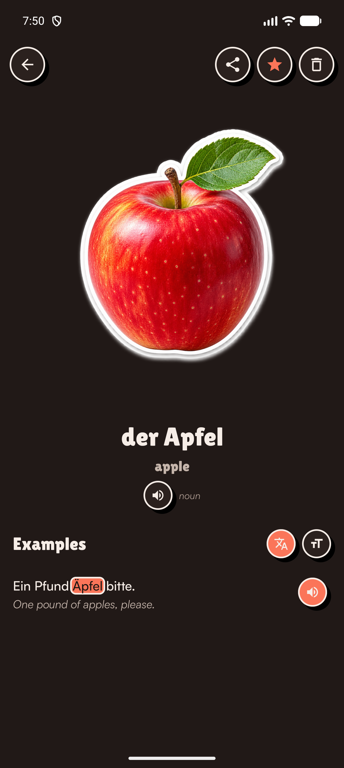
LISTEN AND FOLLOW
The sentence moves with the voice.
Each spoken word is highlighted in real time.
When sentence audio is enabled, the highlight advances word by word with the narration. Learners follow pronunciation and spelling at the same moment, without losing their place.
Hear the sentence. See the word. Connect sound with meaning.
04
Notes:
[Sources]
- Fresh Android emulator captures made during live sentence playback: voice-highlight-2.png and voice-highlight-4.png.
- The highlighted word advances with active sentence audio in the current Vocabloot build.

Slide 5
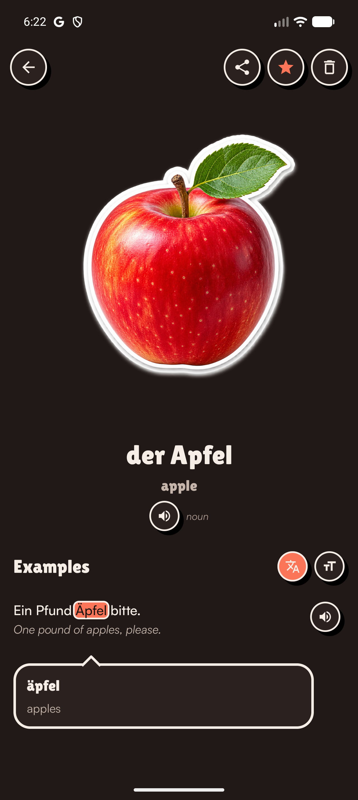
TAP, HIGHLIGHT, UNDERSTAND
Every sentence becomes explorable.
Tap a word. Reveal what it means.
Learners can select an individual word inside an example sentence. Vocabloot highlights it and opens an inline card with its meaning, while sentence audio remains one tap away.
Äpfel
apples
Reading becomes active exploration, not passive memorisation.
05
Notes:
[Sources]
- Fresh Android emulator capture: 37-clickable-word-clean.png (complete highlighted-word and inline-definition interaction).

Slide 6
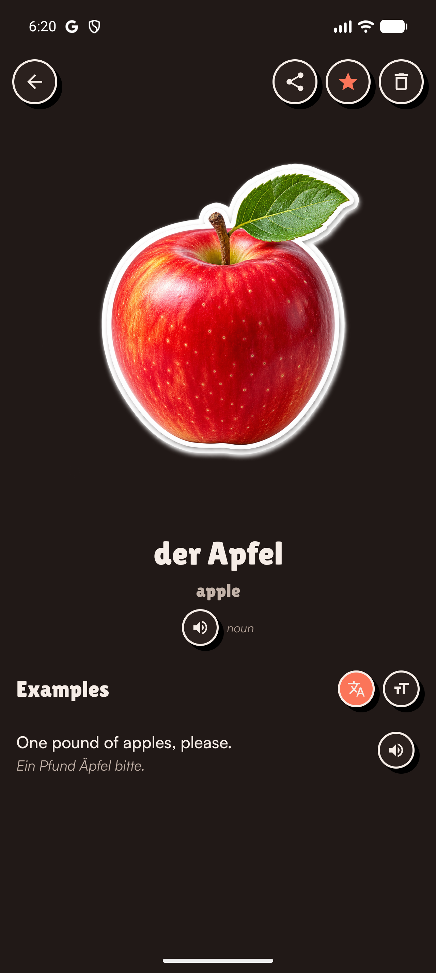
PLANNED DECK ECOSYSTEM
Structured community decks will be visual, audible and playable.
Familiar deck structure, built for the way Vocabloot teaches.
Planned decks will offer the familiar organization of Anki and Quizlet, while every word includes images, text, pronunciation audio, examples and game-ready content. A community layer will let learners create, share and discover decks by language and level.
25
Tamil · Filipino · Romanian · Arabic
and other widely spoken languages
planned languages
06
Notes:
[Sources]
- Fresh Android emulator capture: 31-word-detail-clean.png.
- The 25-language plan and example languages were supplied by the user.
- Structured language- and level-based decks, community creation and sharing, and game-ready multimedia deck content are planned product directions, not current availability claims.
- Anki and Quizlet are referenced only as familiar examples of structured deck organization; no integration or affiliation is claimed.

Slide 7
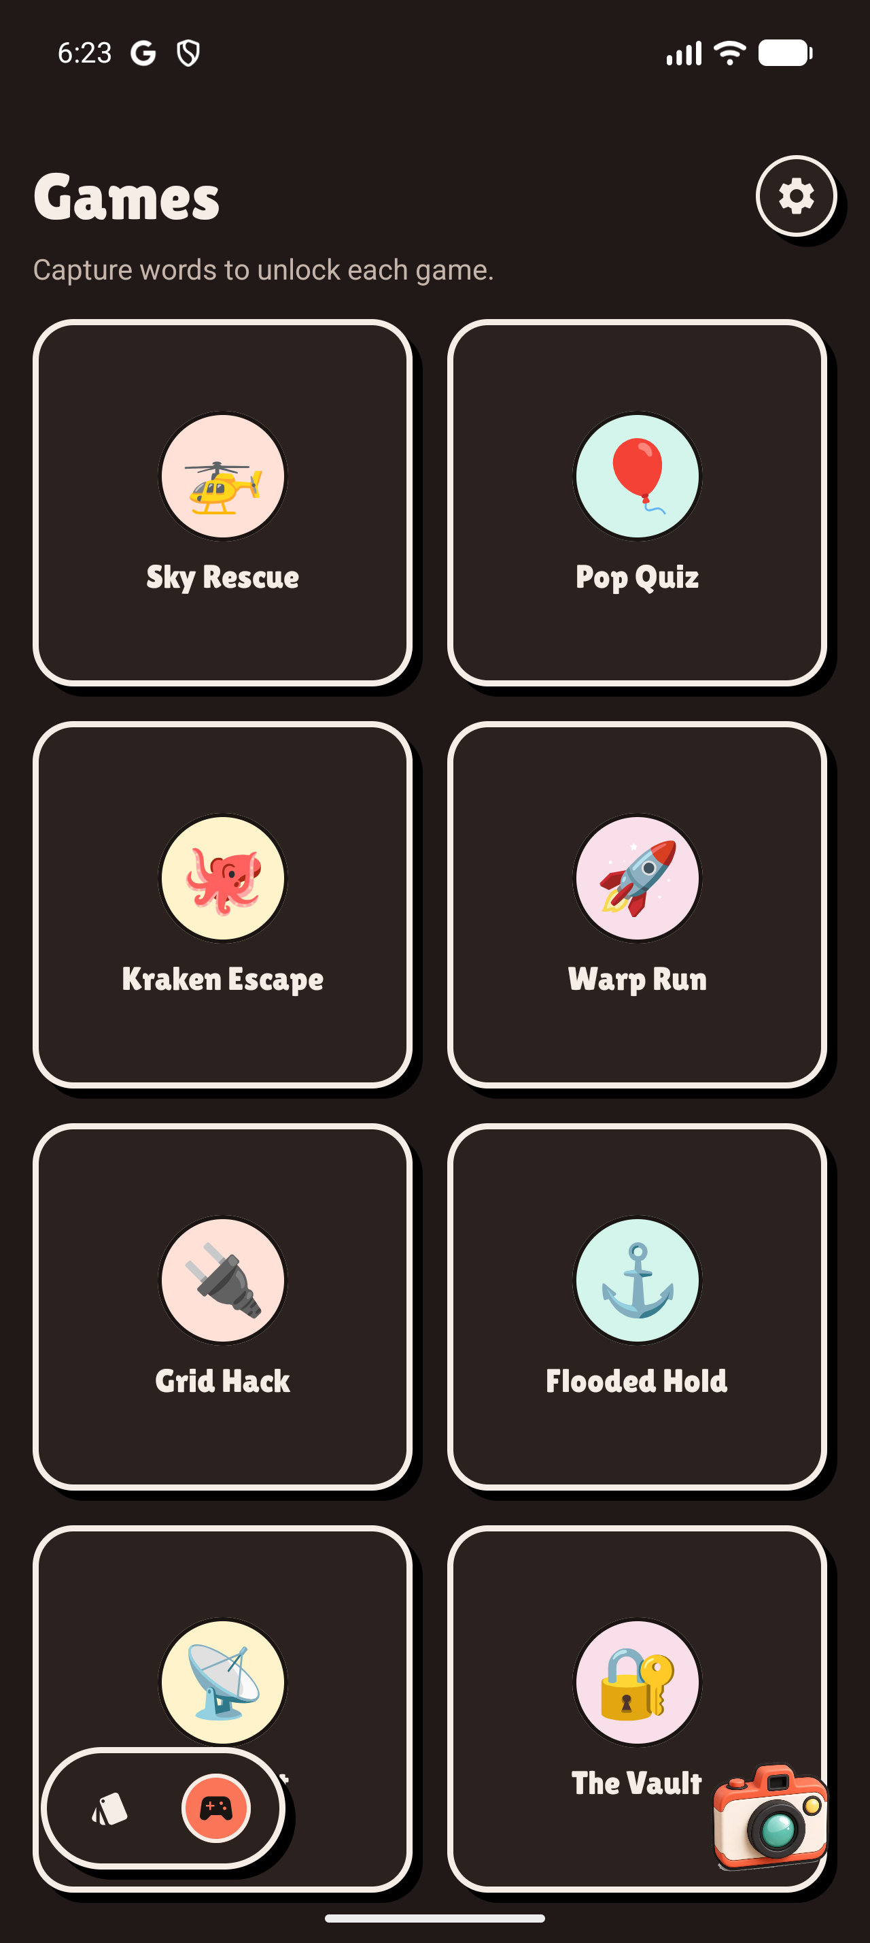
PLAY WITH THE WORDS YOU FOUND
The learner’s own wordbook becomes the arcade.
No streak pressure. No boring flashcards.
Vocabloot uses different game mechanics to practise spelling and meaning, with timers and fast-paced challenges that keep learning engaging. Capturing more words unlocks more ways to play.
Snap more words → unlock more ways to play
Future: Word Hunt lets friends explore real places and collect vocabulary together.
Notes:
[Sources]
- Fresh Android emulator capture: 38-games-clean.png.
- Game names and unlock model verified in the current running build.
- The future multiplayer Word Hunt direction was supplied by the user.

Slide 8
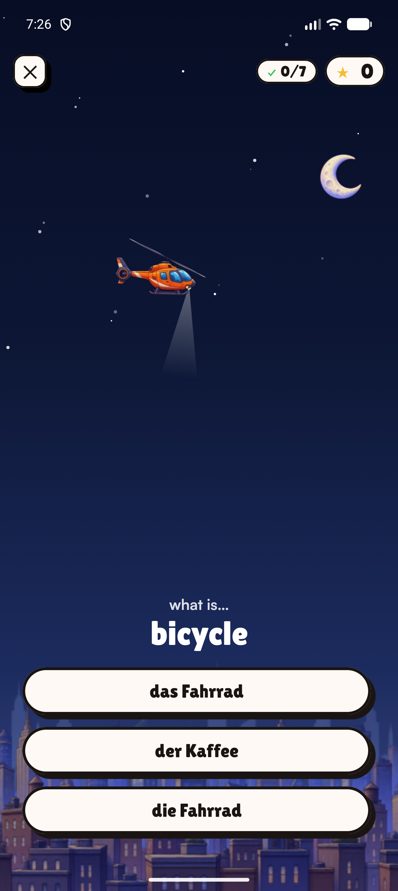
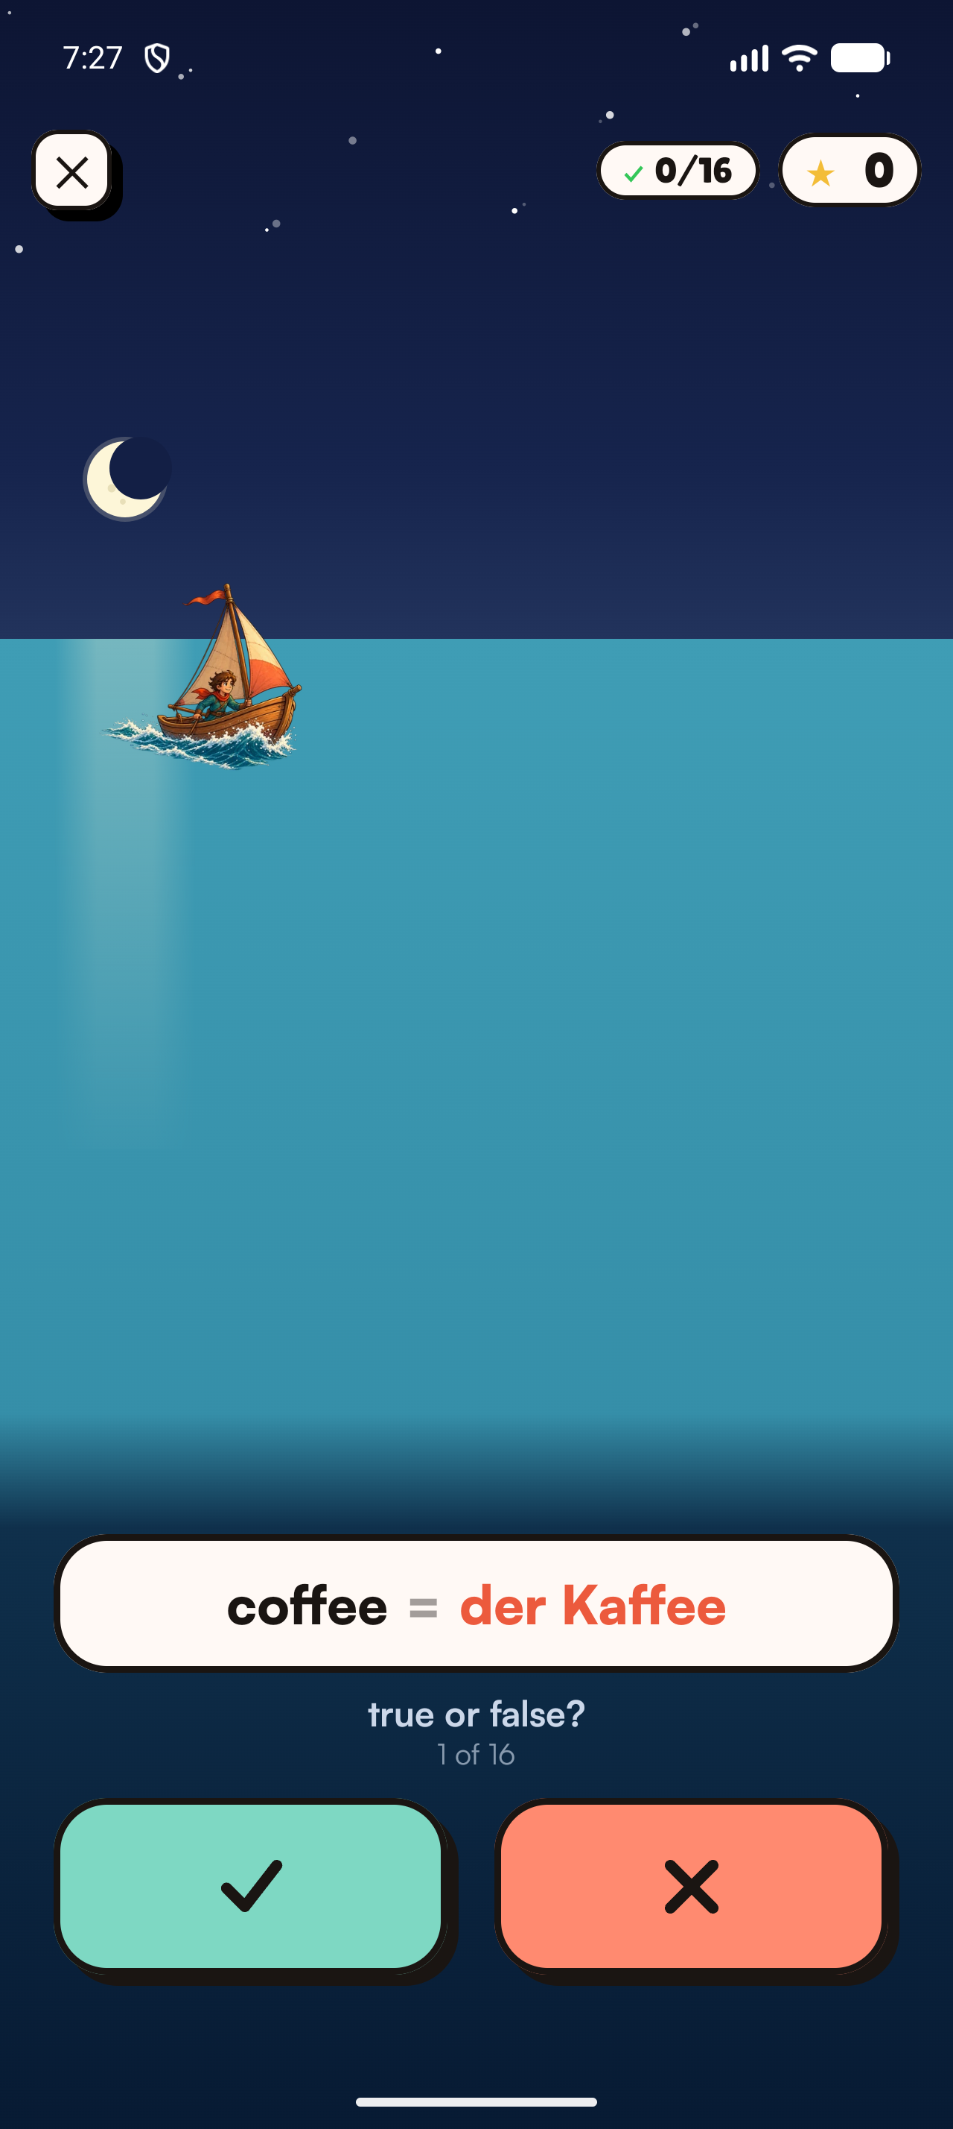
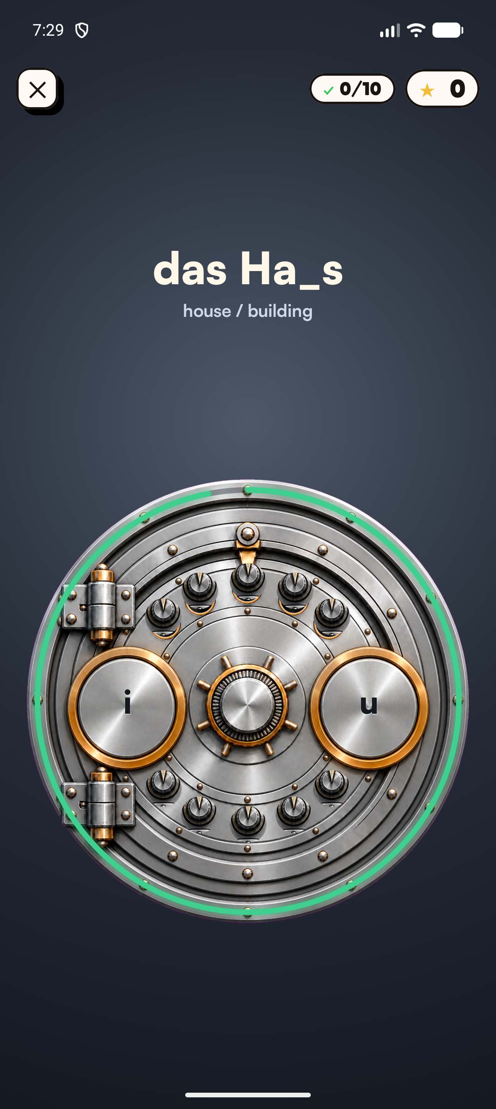
INSIDE THE GAMES
Vocabulary recall becomes an active challenge.
The same personal words feel different in every game.
Time pressure, movement, visible danger, and immediate feedback turn vocabulary retrieval into a goal-driven moment. Learners are not reviewing a static card. They are using the word to rescue, escape, or unlock something.
Recall has a purpose and a consequence.
Sky Rescue
Kraken Escape
The Vault
08
Notes:
[Sources]
- Fresh Android emulator captures: 45-sky-rescue-gameplay.png, 47-kraken-gameplay.png, and 49-vault-gameplay.png.
- Gameplay descriptions are visible in the current running build.

Slide 9
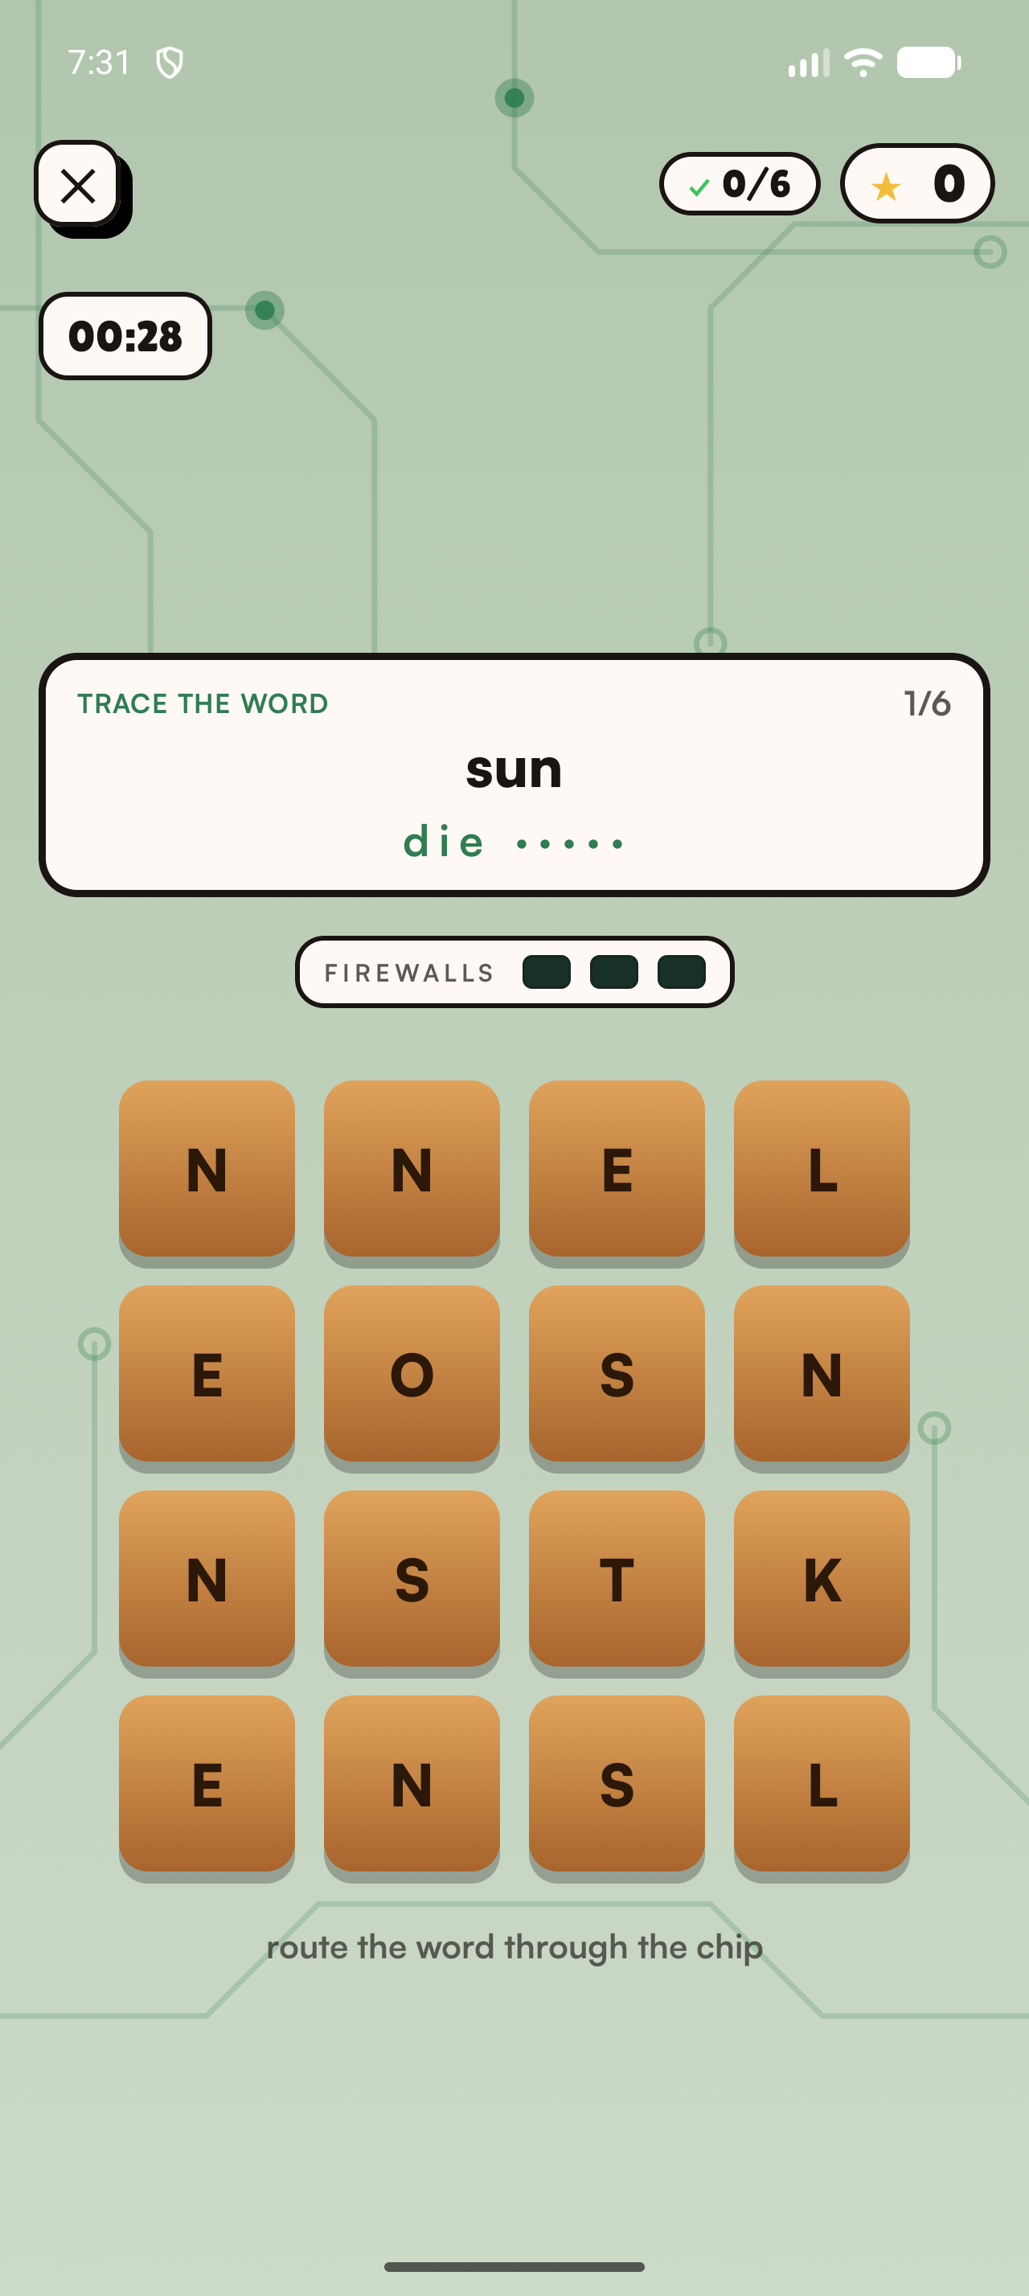
MORE THAN ONE WAY TO PLAY
Different mechanics exercise different vocabulary skills.
Grid Hack turns spelling into navigation.
Learners trace the target-language word through a live letter grid while a countdown runs. The mechanic trains spelling, letter recognition, and recall without presenting another flashcard.
Sky Rescue · fast meaning recall
Kraken Escape · translation verification
The Vault · missing-letter completion
Grid Hack · spelling and visual search
09
Notes:
[Sources]
- Fresh Android emulator capture: 51-grid-hack-gameplay.png.
- Game mechanics and labels verified in the current running build.

Slide 10
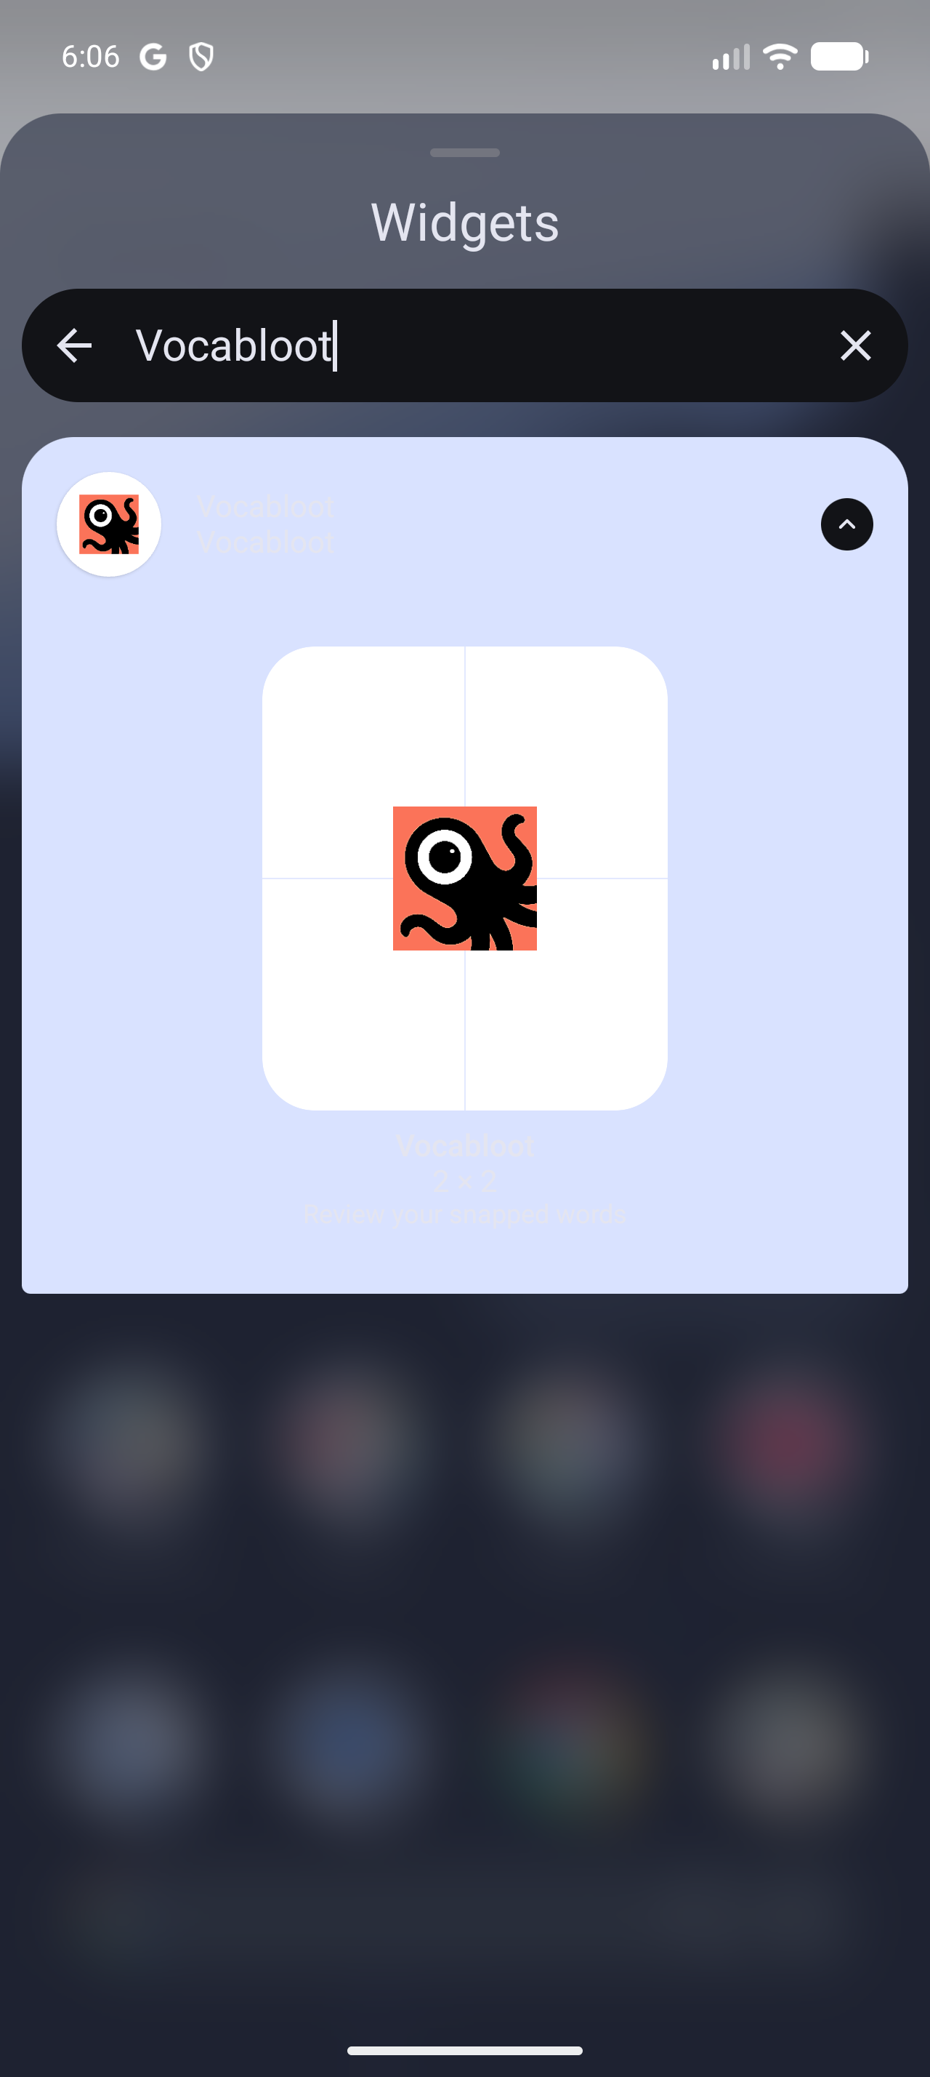
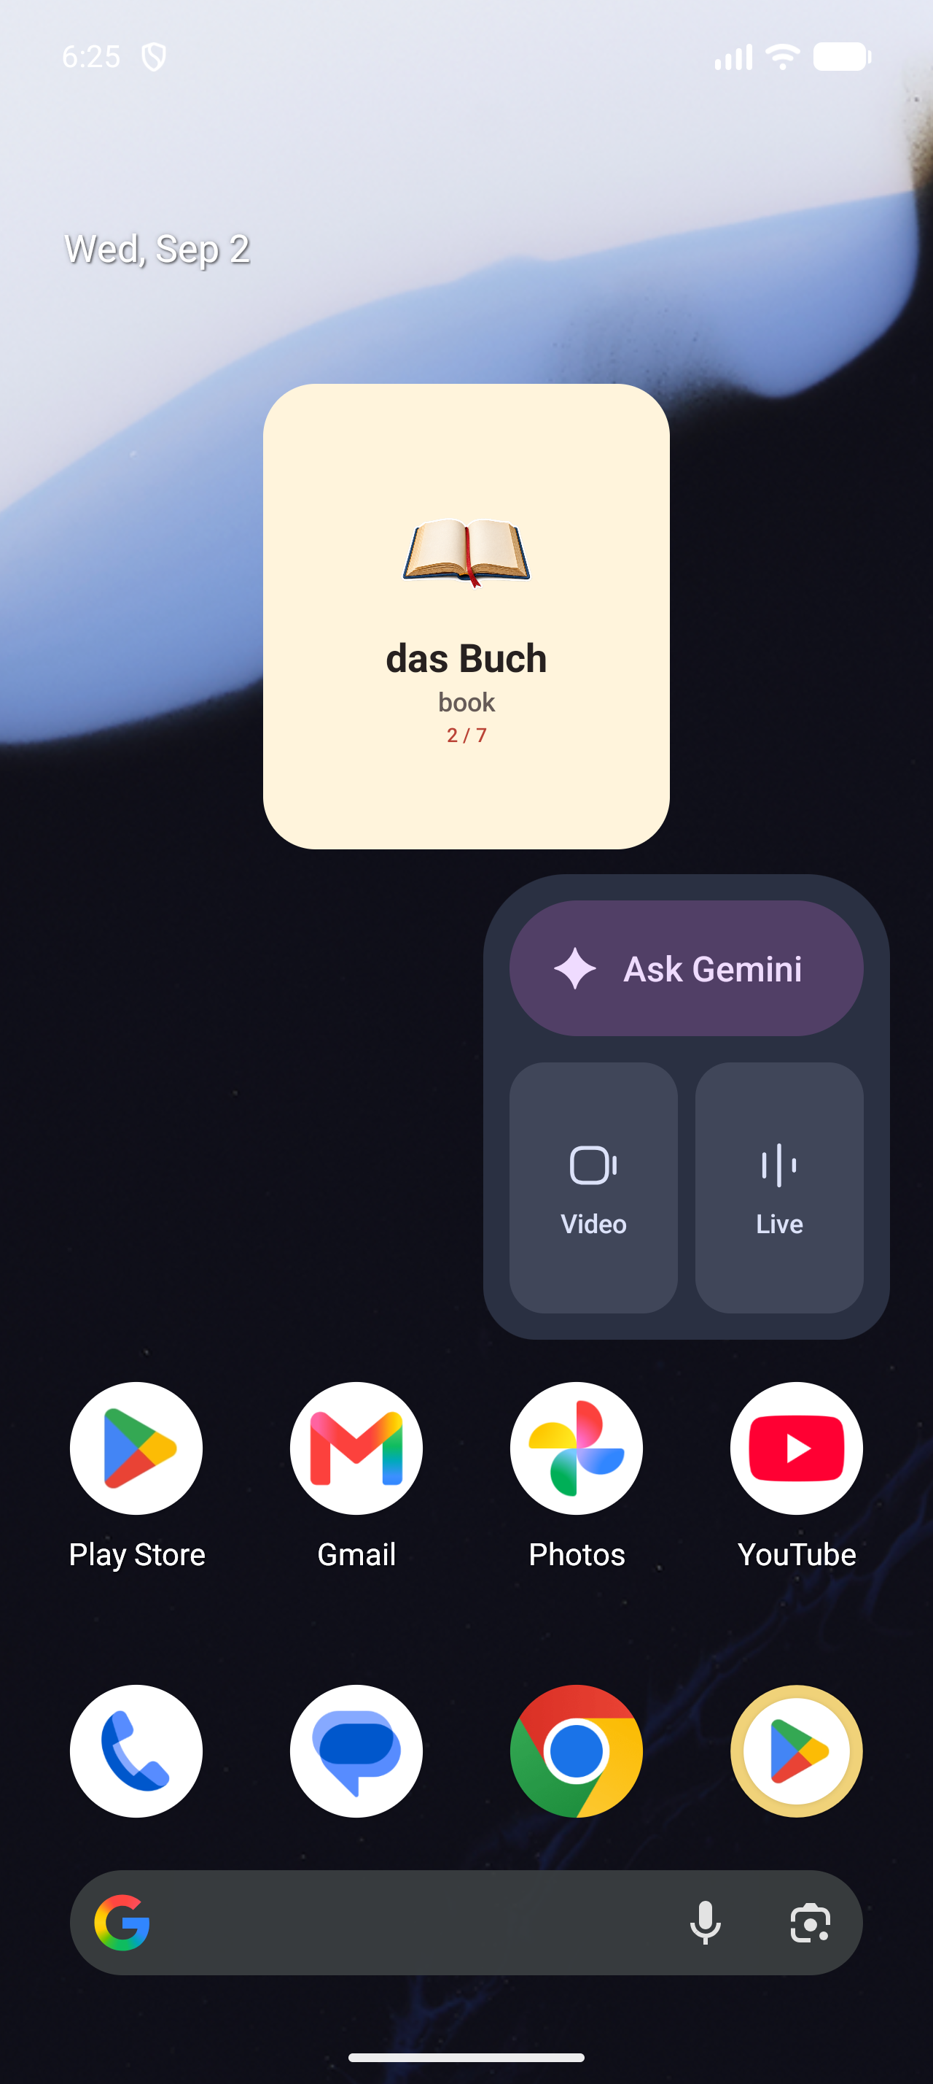
LEARNING BEYOND THE SESSION
A home-screen widget keeps discovered words in view.
Vocabulary returns naturally throughout the day.
The Vocabloot widget surfaces a snapped word, its image, meaning, and progress directly on the home screen. A tap returns to the full word, pronunciation, examples, and clickable sentence vocabulary.
Personal words stay visible without streaks or reminders.
10
Notes:
[Sources]
- Fresh Android emulator captures: 12-widget-picker.png and 43-widget-home-clean.png.

Slide 11
VOICE LAYER AND CONTENT
Voice makes each interaction sound alive.
01
WORD VOICE
02
SENTENCE VOICE
Natural pronunciation for every snapped word.
Expressive playback for contextual examples.
03
CLICKABLE WORDS
04
NARRATED CONTENT
Voice and meaning when a learner explores a sentence word by word.
Audio editions of vocabulary newsletters and short lessons that return learners to the app.
11
Notes:
[Sources]
- Narrated newsletter plan supplied by the user.

Slide 12

PLANNED NEWSLETTER AND SOCIAL OUTREACH
A planned daily outreach format will extend learning beyond the app.
Planned: Learn 1,000 <language> words in 90 days
IMAGE · TEXT · TTS · EXAMPLE SENTENCE
SYNCHRONISED HIGHLIGHTING · VOICE
Not launched yet. We plan two daily emails with six words each, plus daily short-form lessons on Instagram, YouTube, TikTok, Facebook and other relevant social platforms.
2
emails per day
6
words per email
1,080 slots
1,000 unique
1,000
unique words
80
review slots
12
Notes:
[Sources]
- This newsletter and social outreach is planned and has not launched yet.
- Planned daily distribution includes Instagram Reels, YouTube Shorts, TikTok, Facebook, the newsletter and other relevant short-form social platforms.
- Arithmetic: 2 emails/day × 6 words/email × 90 days = 1,080 word slots; the planned sequence uses 1,000 unique words and 80 deliberate review or repetition slots.
- Fresh Android emulator capture: 28-word-detail-clean.png.

Slide 13

PRODUCT STATUS
Live on mobile; ready to scale the voice experience.
NOW
Live camera, wordbook, games, widgets
NEXT
Natural voice across words and sentences
APP STORE
GOOGLE PLAY
apps.apple.com/app/id6792888619
play.google.com/store/apps/details?id=com.tntstudios.snaplingo
THEN
Speaking practice and multiplayer Word Hunt
Vocabloot is already live with a free experience and premium subscription path.
AVAILABLE NOW: Learning notifications · images shared from other apps
Photo-library imports · vocabulary deck import and export
13
Notes:
[Sources]
- First-party Vocabloot artwork: iosApp AppIcon Icon-1024.png.
- App Store listing: https://apps.apple.com/app/id6792888619
- Google Play listing: https://play.google.com/store/apps/details?id=com.tntstudios.snaplingo
- Live status supplied in the user’s application; store-release and subscription implementation verified in the repository.
- Learning notifications, image sharing from other apps and the photo library, and vocabulary deck import/export are existing product capabilities supplied by the user.

Slide 14
TEAM AND PRODUCT DIRECTION
A lean team ready to make vocabulary audible.
Next, Vocabloot will…
THREE-PERSON TEAM
Product and technology
Expand natural audio across the personal wordbook
Test listening-led vocabulary experiences
Marketing and design
Scale narrated newsletters and lessons
Build toward speaking and pronunciation practice
Clear ownership across building and growing Vocabloot.
Make new words easier to hear, remember, and use.
14
Notes:
[Sources]
- Team structure supplied by the user.
- Vocabloot project listing: https://devpost.com/software/vocabloot

